Slide 1

Oncoplastic Certification Level 1
Case Submission
Applicant Name:
EXAMPLE
Tip: We suggest the use of a “Snip & Sketch” tool found in Microsoft accessories (or equivalent application) to easily select and transfer images. This will allow you to submit the required documentation without any PHI/identifiers, as well.

Slide 2

Case #: EXAMPLE
Procedure:
Crescent Mastopexy
Pre-Operative Photos
With Markings
Pre OP
Lateral view to the left (15-90*)
Full Frontal
Lateral view to the right (15-90*)

Slide 3
Case #: EXAMPLE
Procedure:
Crescent Mastopexy
Post-Operative Photos
6 Months post op
Lateral view to the right (15-90*)
Full Frontal
Lateral view to the left (15-90*)

Slide 4
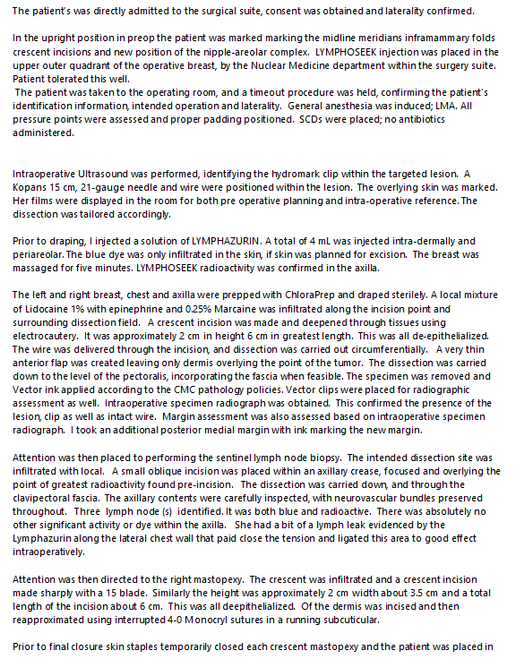
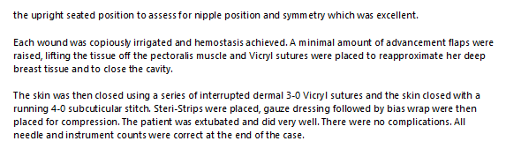
Case #: EXAMPLE
Operative Report

Slide 5
Case #: EXAMPLE
Operative Report
(additional slide if needed)

Slide 6
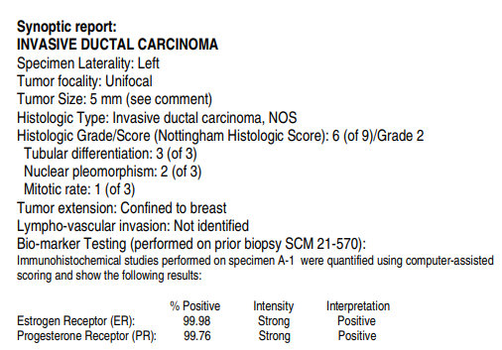
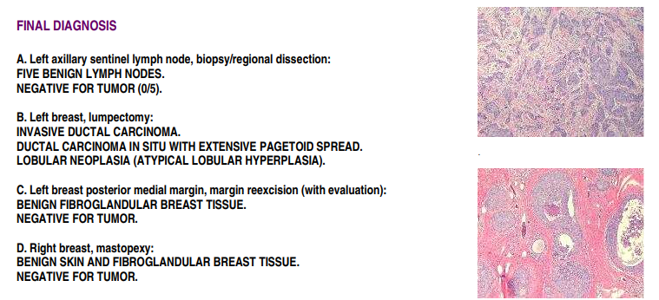
Case #: EXAMPLE
Pathology Report

Slide 7
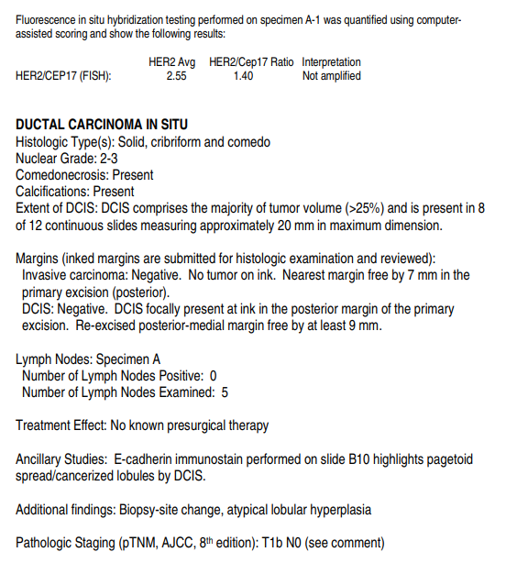
Case #: EXAMPLE
Pathology Report
(additional slide if needed)

